Slide 1
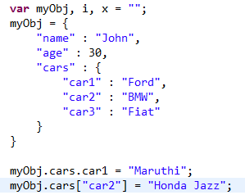
Nested JSON Objects - Modify Values
We can use the dot notation to modify any value in a JSON object
or
We can also use the bracket notation to modify a value in a JSON object

